Slide 1
PRESIDENT’S REPORT​
Mun Y. Choi​
Board of Curators Meeting​
June 27, 2024​

Slide 2
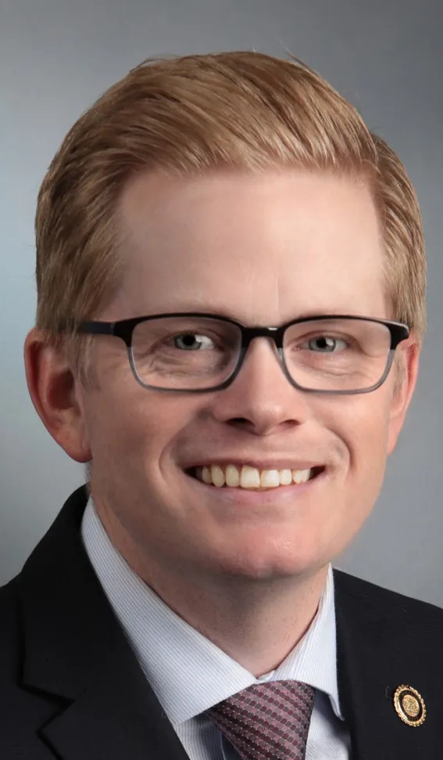
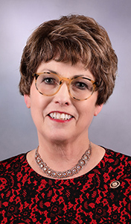
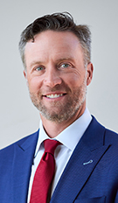
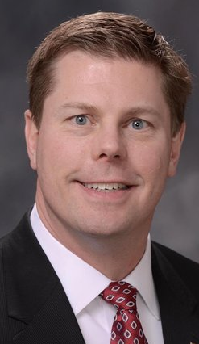
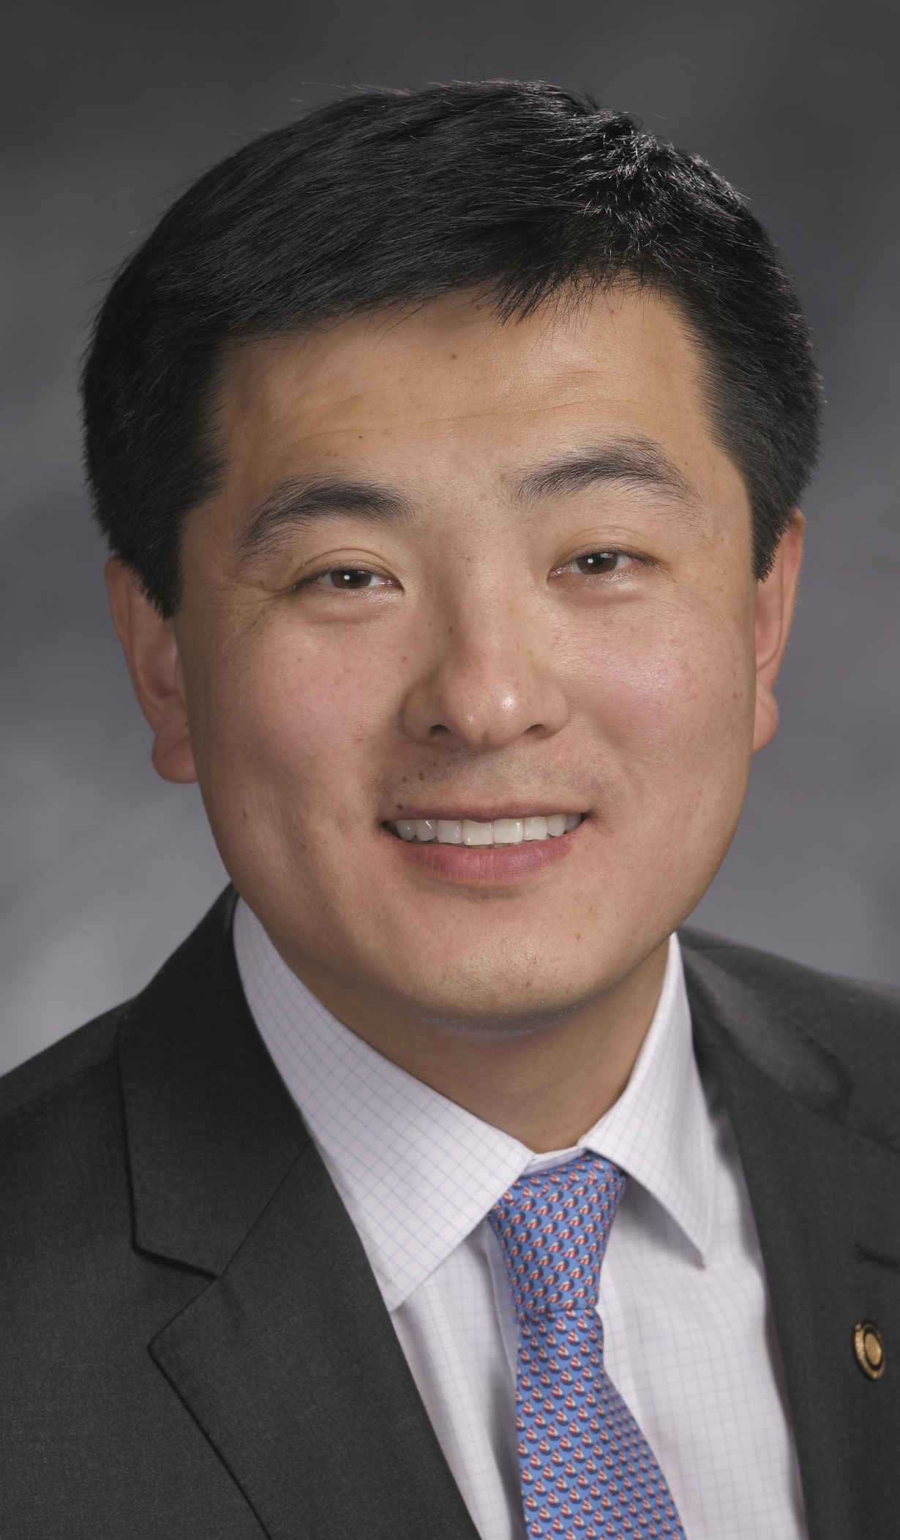
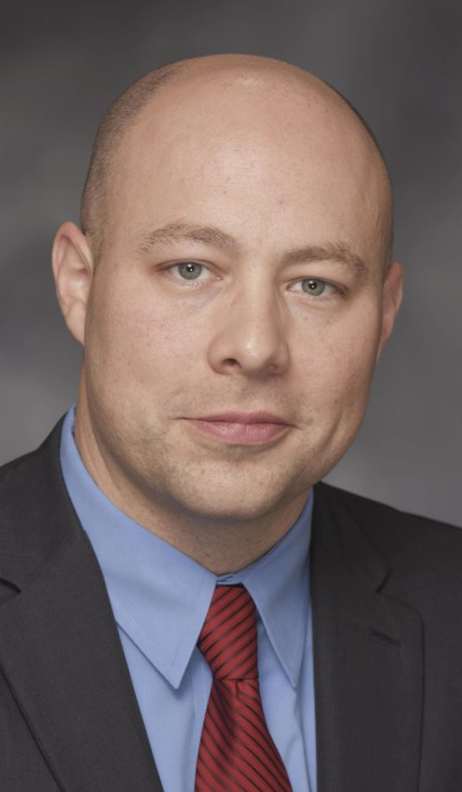
Core Appropriations: $510M*
5th Straight Year of Increase
3% Core Funding Increase
UM Core - $242.9M (+$8M)
Professional Doctorate Degrees - $104M (+$3M)
Research and Development Core - $82M (+$2M)
Land Grant Core - $29.7M (+$5M)
$18M for MoExcels Projects

Slide 3
Additional State Funding*
ARPA Funds
$52M – NextGen/CEI/MURR
$25M – Advancing Missouri’s STEM Education
and Workforce Development
$20M – UMKC Health Sciences District
$25M – Campus of the Future Transformation Program
HB 3 | HB 6 | HB 8 | HB 20
$1M for MU ALOT Program | $10M for MU Meat Processing Plant | $1M for the Missouri National Guard Tuition Assistance | $25M for UMSL Engineering Program
$1M for the Missouri Returning Heroes Program | $3M for MU Eckles Hall Wine & Grape Institute |  | $20M for MU Radioisotope Distribution Center
$250K for S&T Project Lead the Way

Slide 4
Admissions Update
FTC Accepted (Active) Students
06/24/24 | 2022​ | 2023​ | 2024
MU​ | 5,117 | 5,298 | 6,232 (18%)
UMKC​ | 1,356 | 1,485 | 1,514 (2%)
S&T​ | 1,150 | 1,314 | 1,463 (11%)
UMSL​ | 428 | 522 | 574 (10%)

Slide 5
Admissions Update
Transfer Accepted (Active) Students
06/24/24 | 2022​ | 2023​ | 2024
MU​ | 1,113 | 1,050 | 1,141 (9%)
UMKC​ | 930 | 987 | 989 (0.2%)
S&T​ | 202 | 327 | 401 (23%)
UMSL​ | 912 | 904 | 912 (1%)

Slide 6
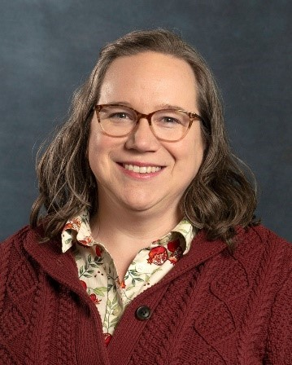
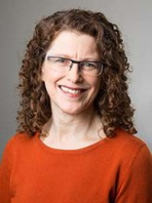
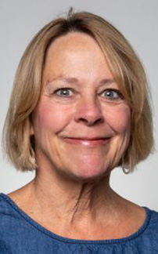
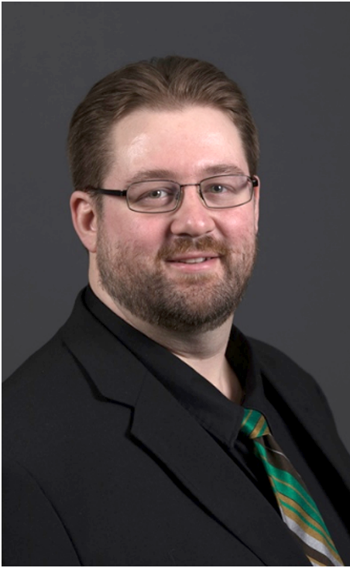
Governor’s Award for Teaching Excellence
Aimee Dunlap
Biology
Gayle Levy
World Languages and Cultures
Governor's Award for Excellence in Teaching 2024 UMSL recipient
Governor's Award for Excellence in Teaching 2024 UMKC recipient
Lee Ann Lowery
Occupational Therapy
Joshua Schlegel
Nuclear Engineering
Governor's Award for Excellence in Teaching 2024 Mizzou recipient
Governor's Award for Excellence in Teaching 2024 S&T recipient
Notes:
UMSL:
UMKC:
MU:
S&T:

Slide 7
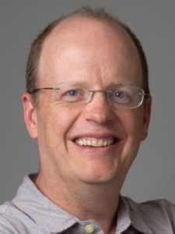
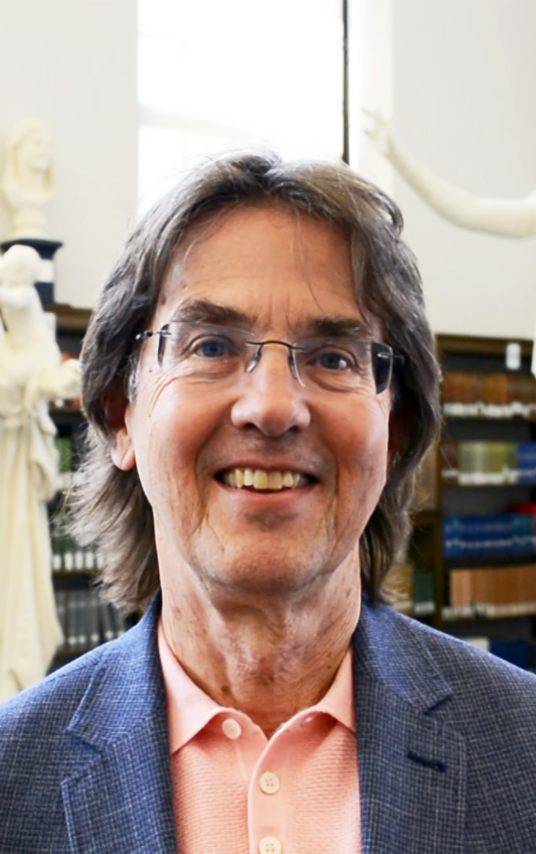
Faculty Success Highlights
Dr. Xuemin Wang
Biology
Dr. Jeff Rydberg-Cox
Dr. Diane Mutti-Burke
Co-directors, Center for Digital and Public Humanities
Recipient of the 2024 Terry Galliard Medal from the International Symposium on Plant Lipids
Awarded Andrew W. Mellon Foundation Grant to support the humanities
Dr. Dennis Trout
History
Dr. Baojun Bai
Petroleum Engineering
Awarded a Rome Prize Fellowship from the American Academy in Rome.
Recipient of the Improved Oil Recovery Pioneer Award from the Society of Petroleum Engineers
Notes:
UMSL:
UMKC:
MU:
S&T:

Slide 8
FYTD Federal R&D Expenditures
90%
76%
111%
-22%

Slide 9
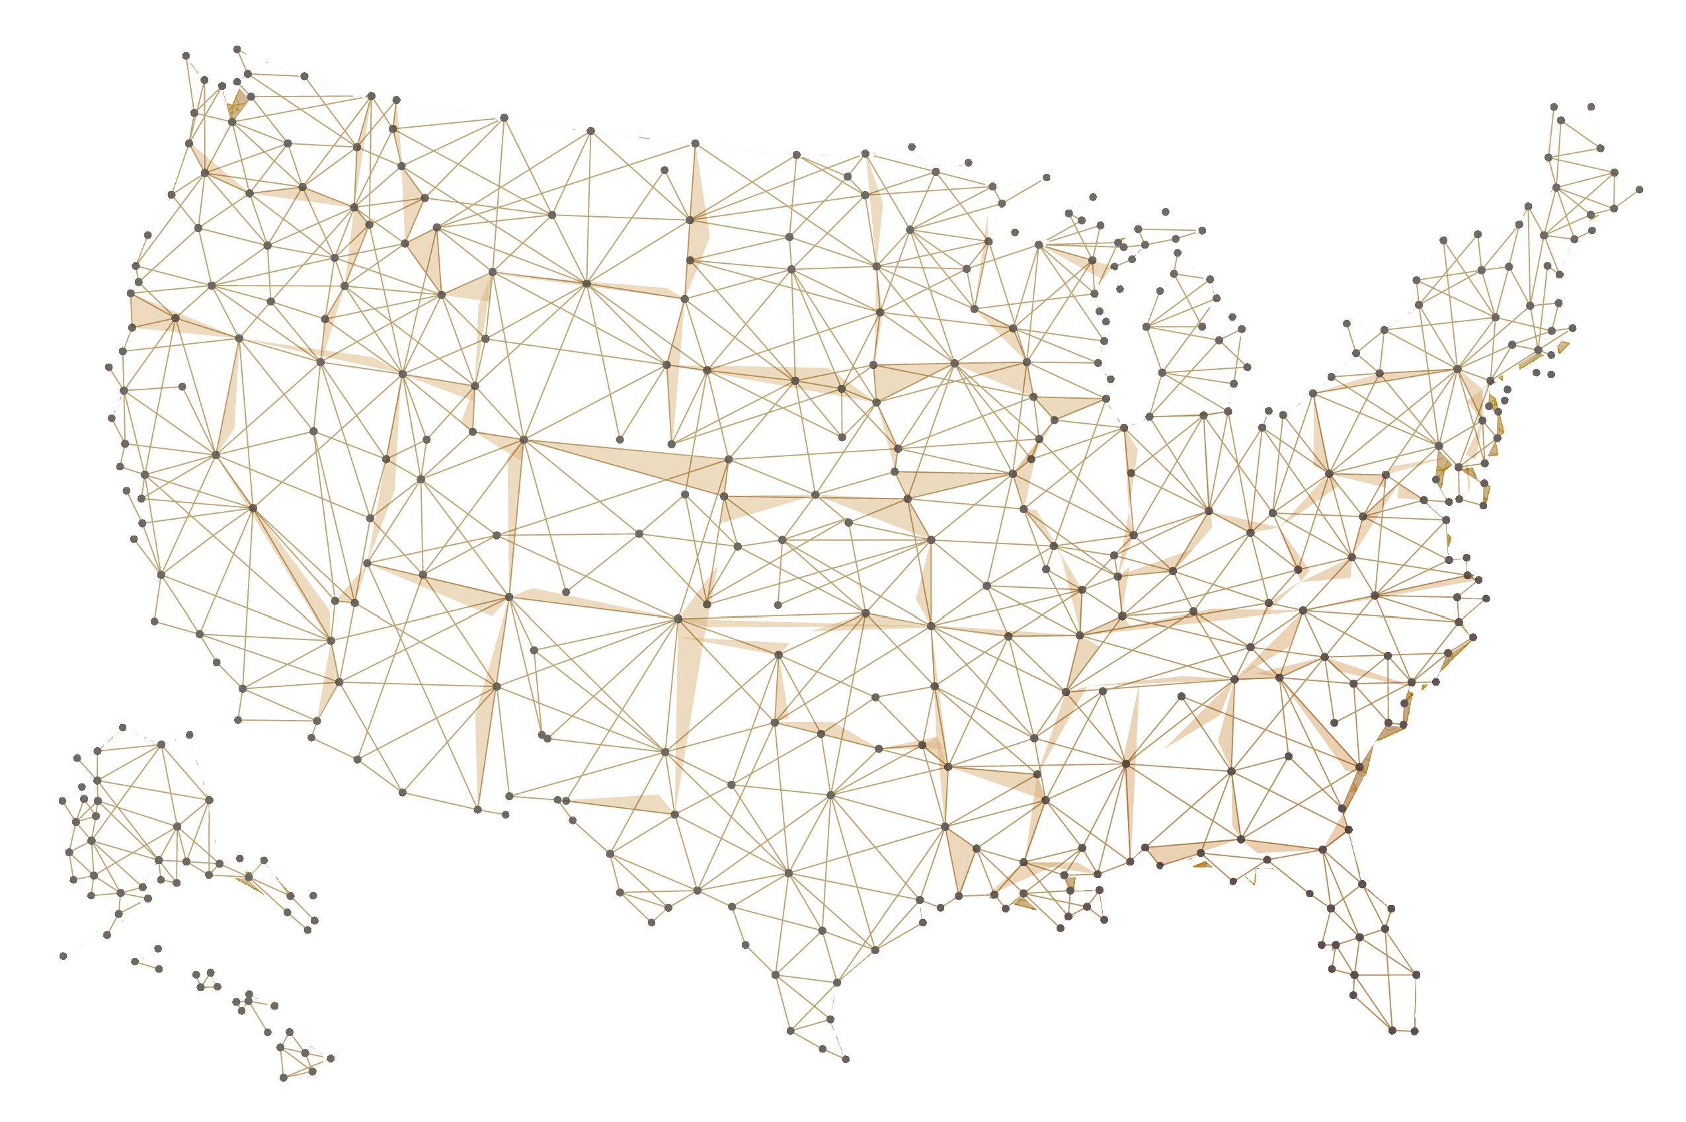
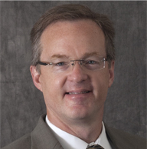
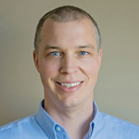
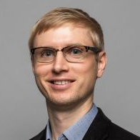
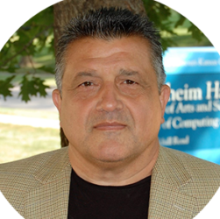
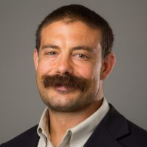
Top 100 Universities Granted U.S. Utility Patents
Dr. Baojun Bai
Dr. Thomas Schuman
Re-assembling polymer particle package for conformance control and fluid loss control
Dr. Matthew Masschmann
Dr. Matthias Young
Area selective nanoscale-thin layer deposition via precise functional group lithography
65/100 Nationwide
.
UM System
26 U.S. Utility Patents
Dr. Plamen Doynov
Dr. Tony Caruso
High-efficiency high-power microwave generation using multipass non-linear network topologies
Source: The National Academy of Inventors, 2023

Slide 10
S&T Major Grant
Thermal Protection for Hypersonic Vehicles
PI: Dr. Greg Hilmas, Curators' Distinguished Professor, Materials Science and Engineering Co-PIs:
Dr. D. Lipke, Materials Science and Engineering;
Dr. W. Fahrenholtz, Curators' Distinguished Professor, Materials Science and Engineering;
Dr. K. Chandrashekhara, Curators' Distinguished Professor, Mechanical and Aerospace Engineering;
Dr. J. Lonergan, Materials Science and Engineering;
Dr. J. Watts, Materials Science and Engineering;
Dr. A. Emdadi, Materials Science and Engineering
$4.8M
Sponsor: General Electric Company
This is the second phase of an aggressive research and development project that advances understanding and maturity of composite materials for use in aerospace engineering.
Hypersonic vehicles fly at speeds greater than Mach 5, where high heat loads occur.

Slide 11
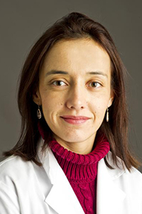
MU Major Grant
SGLT2 Inhibition as a Therapeutic Strategy to Reverse Arterial Stiffening in Aging
PI: Dr. Camila Manrique-Acevedo, Thomas W. Burns Distinguished Professor in Diabetes, Department of Medicine
Co-PIs: Dr. Luis Martinez-Lemus, Medical Pharmacology and Physiology, Dr. Jaume Padilla, Nutrition and Exercise Physiology
$3M
Sponsor: National Institutes of Health
This project will determine the molecular mechanisms underlying arterial stiffening in aging and, for the first time, examine the efficacy of sodium glucose co-transporter 2 (SGLT2) inhibition in reversing aging-associated arterial stiffening.
Cardiovascular disease is the main cause of death in older adults.
Notes:
TITLE: SGLT2 inhibition as a therapeutic strategy to reverse arterial stiffening in aging
PI: Camila Manrique-Acevedo, Thomas W. Burns, MD, Distinguished Professor in Diabetes; Director of Faculty Research, Department of Medicine; Professor of Medicine, School of Medicine; and Roy Blunt NextGen Precision Health Care building Researcher
Co-PIs: Luis Martinez-Lemus, Professor, Medical Pharmacology and Physiology, School of Medicine; and Roy Blunt NextGen Precision Health Care building Researcher
Jaume Padilla, Associate Professor, Nutrition and Exercise Physiology, College of Agriculture, Food and Natural Resources; and Roy Blunt NextGen Precision Health Care building Researcher
Amount: $3,000,355
Funding Agency: National Institutes of Health
Description: Cardiovascular disease (CVD) is the main cause of death in older adults in the U.S. and the burden of aging-associated CVD is expected to increase as the percentage of the older population steadily grows. A key characteristic of vascular aging is arterial stiffening, which is a causal factor and independent prognosticator of cardiovascular morbidity and mortality. This project will determine the molecular mechanisms underlying arterial stiffening in aging and, for the first time, examine the efficacy of sodium glucose co-transporter 2 (SGLT2) inhibition in reversing aging-associated arterial stiffening.
Sources: https://reporter.nih.gov/search/rDPwnF4uCUG9LngkU30DfQ/project-details/10814507

Slide 12
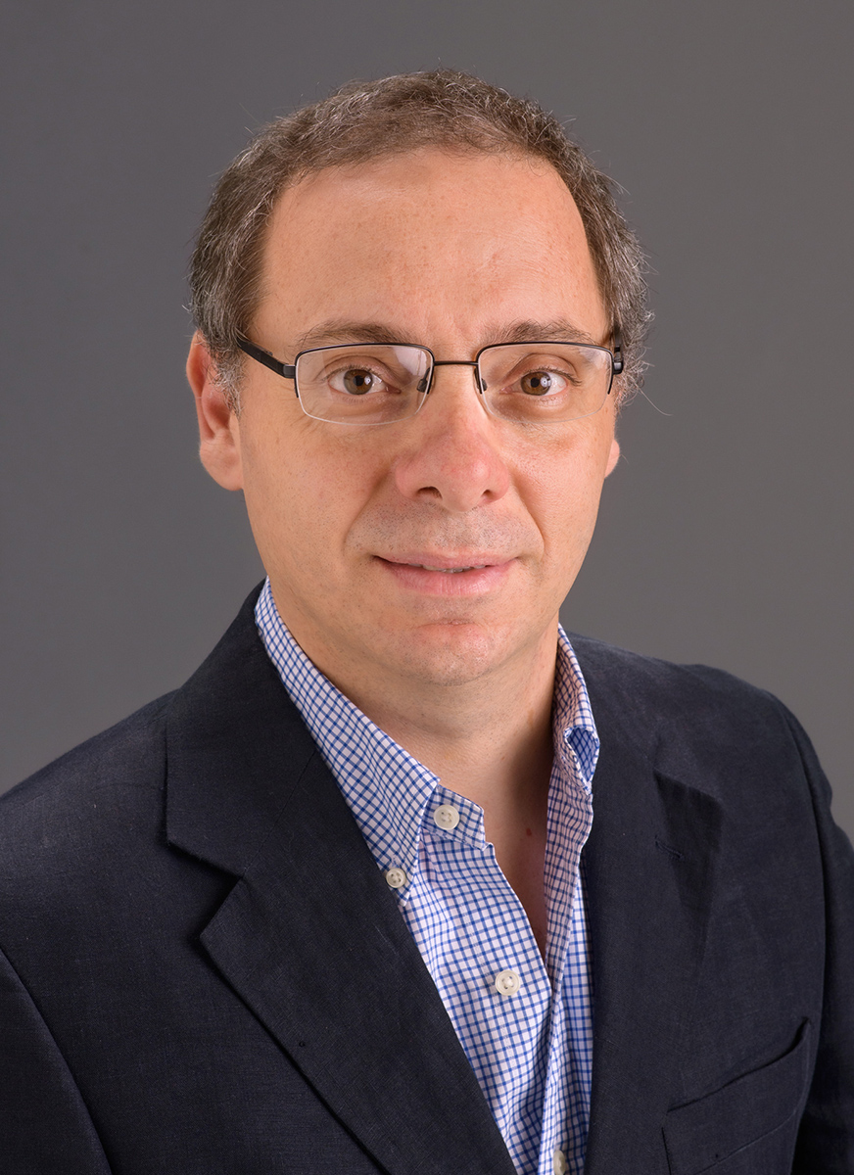
MU Major Grant
p16 Cellular Senescence and Vascular Dysfunction
in Sleep Apnea
PI: Dr. Rene Cortese, Pediatrics and Obstetrics, Gynecology and Women's Health, School of Medicine
Co-I: Dr. Mohammad Badran, Pediatrics
$2.9M
Sponsor: National Institutes of Health
The grant will be used to investigate the phenotypic effects and molecular mechanisms of Obstructive Sleep Apnea (OSA)-induced vascular senescence, and their reversibility through selective targeting of senescent cells in the vasculature.
Approximately 39 million U.S. adults have OSA, according to the National Council on Aging.
Notes:
TITLE: p16 Cellular Senescence and Vascular Dysfunction in Sleep Apnea
PI: Rene Cortese, Research Assistant Professor, Pediatrics; and Obstetrics, Gynecology and Women's Health, School of Medicine
Co-I: Mohammad Badran, Research Assistant Professor, Pediatrics, School of Medicine
Amount: $2,936,369
Funding Agency: National Institutes of Health
Description: The grant will be used to investigate the phenotypic effects and molecular mechanisms of Obstructive Sleep Apnea (OSA)-induced vascular senescence, and their reversibility through selective targeting of senescent cells in the vasculature.
Source: https://reporter.nih.gov/search/7il3p4bihU-di3bxNybnCA/project-details/10977909

Slide 13
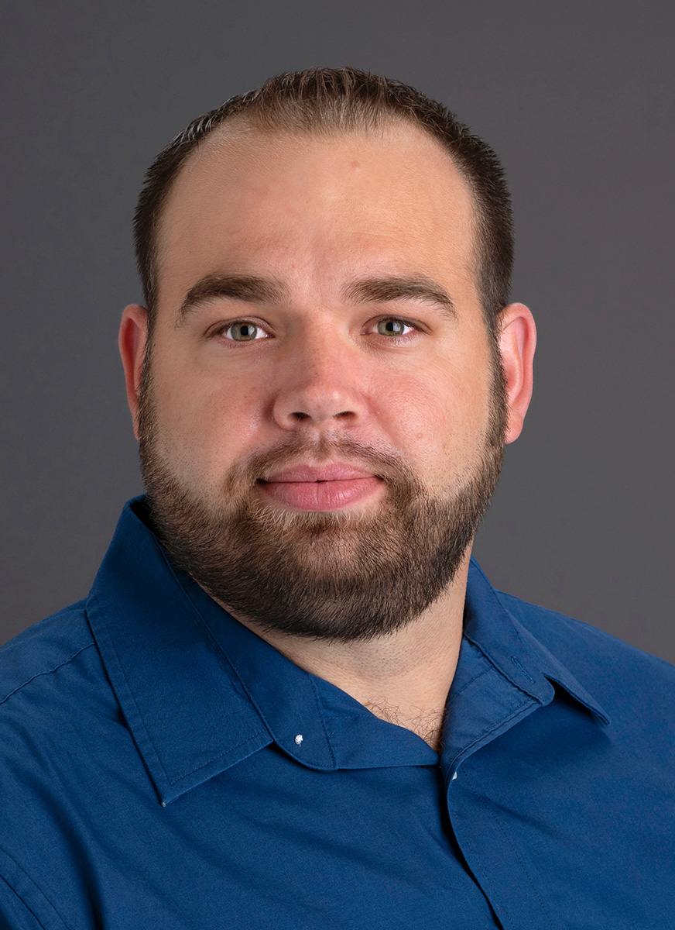
MU Major Grant
Regulation of Lymphatic Muscle Cell Function by Store Operated Calcium eEntry Signaling
PI: Dr. Scott Zawieja, Medical Pharmacology and Physiology, School of Medicine
Co-I:
Dr. Luis Polo-Parada, Medical Pharmacology and Physiology, School of Medicine;
Steven S. Segal, Curators’ Distinguished Professor and Margaret Proctor Mulligan Professor in Medical Research, Medical Pharmacology and Physiology
$2.9M
Sponsor: National Institutes of Health
The central goal of this proposal is to explore the prevailing hypothesis for the pathogenesis of secondary lymphedema to identify novel targets for pharmacological intervention in lymphedema patients and may shed light on lymphatic collecting vessel contractile dysfunction reported in obesity, diabetes and hypertension.
Secondary lymphedema, afflicting 1 in 1,000 Americans, poses a significant financial and health burden, resulting in a debilitating and incurable swelling and fibrosis in the affected extremity or tissue.
Notes:
TITLE: Regulation of lymphatic muscle cell function by store operated calcium entry signaling
PI: Scott Zawieja, Assistant Professor, Medical Pharmacology and Physiology, School of Medicine
Co-I: Luis Polo-Parada, Associate Professor, Medical Pharmacology and Physiology, School of Medicine
Steven S. Segal, Curators Distinguished Professor, Chancellor's Professor of Research Excellence and Margaret Proctor Mulligan Professorship in Medical Research, Medical Pharmacology and Physiology, School of Medicine
Amount: $2,862,683
Funding Agency: National Institutes of Health
Description: Secondary lymphedema, afflicting 1 in 1,000 Americans, poses a significant financial and health burden, resulting in a debilitating and incurable swelling and fibrosis in the affected extremity or tissue. The central goal of this proposal is to explore the prevailing hypothesis for the pathogenesis of secondary lymphedema to identify novel targets for pharmacological intervention in lymphedema patients and may shed light on lymphatic collecting vessel contractile dysfunction reported in obesity, diabetes and hypertension.
Source: None

Slide 14
FYTD Philanthropy
$355 M

Slide 15
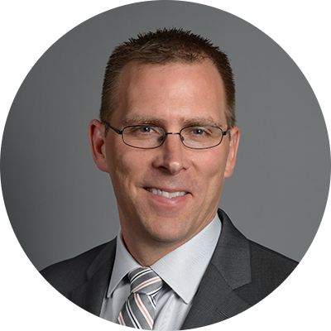
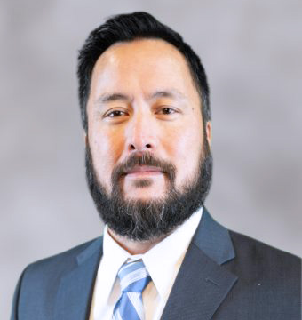
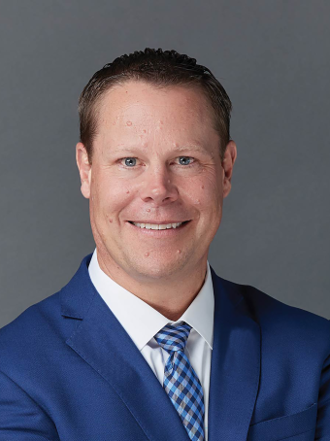
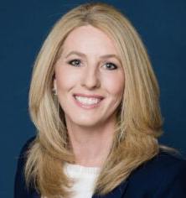
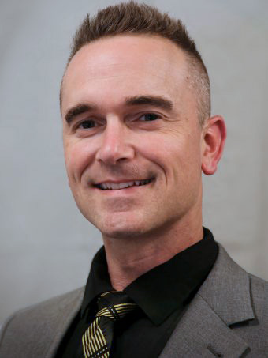
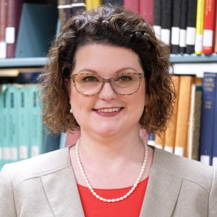
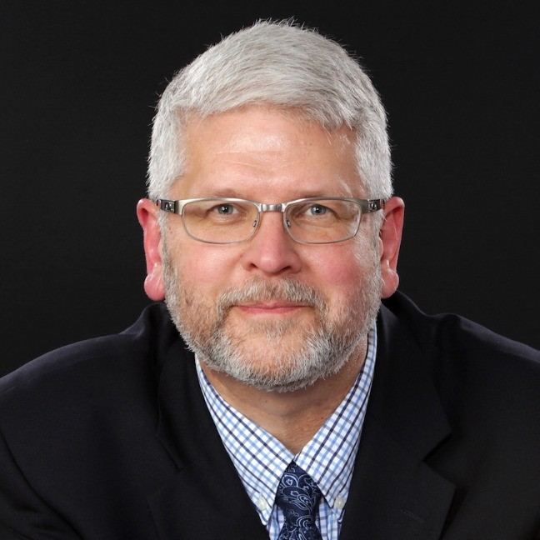
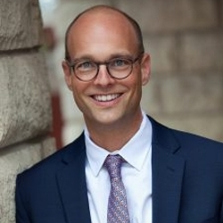
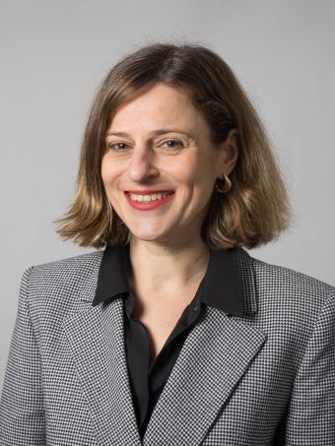
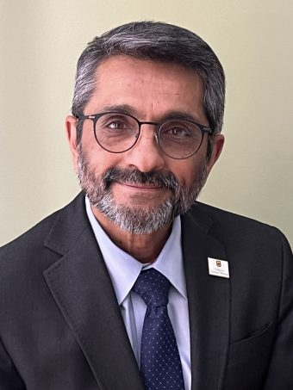
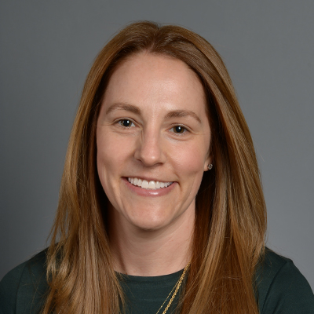
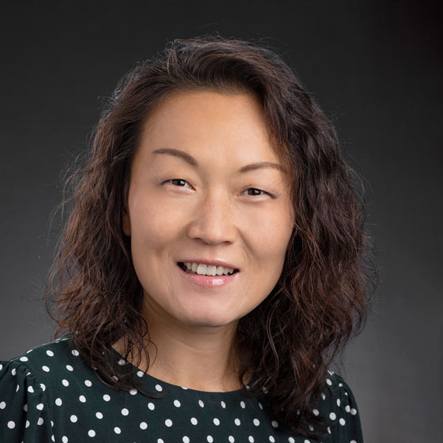
UM Leadership Appointments
Matt Martens
Provost and Executive Vice Chancellor for Academic Affairs
Ben Canlas UM Vice President of Information Technology & MU CIO
Laird Veatch Athletic Director,
Mizzou Athletics
Dr. Robin Gore Vice Chancellor for Student Success
Michael Hoehn, II Program Director of NextGen MURR
Kara Whatley
MU Vice Provost for Libraries and University Librarian
Barry Robbins Chief Information Officer
James D. Sterling Vice Provost and Founding Dean of Kummer College
Alexander Holsinger Vice Provost of
Faculty Affairs
Jeremy Scarbrough Associate Vice Chancellor for Health Systems
Marisa Chrysochoou Dean of the
College of Engineering
Srinand Sreevatsan Dean of the College of Veterinary Medicine
Sarah Diem
Interim Dean of the College of Education and Human Development
Norma Halls-Thomas
Dean of the
College of Nursing
Shu Schiller
Dean of the
College of Business

Slide 16
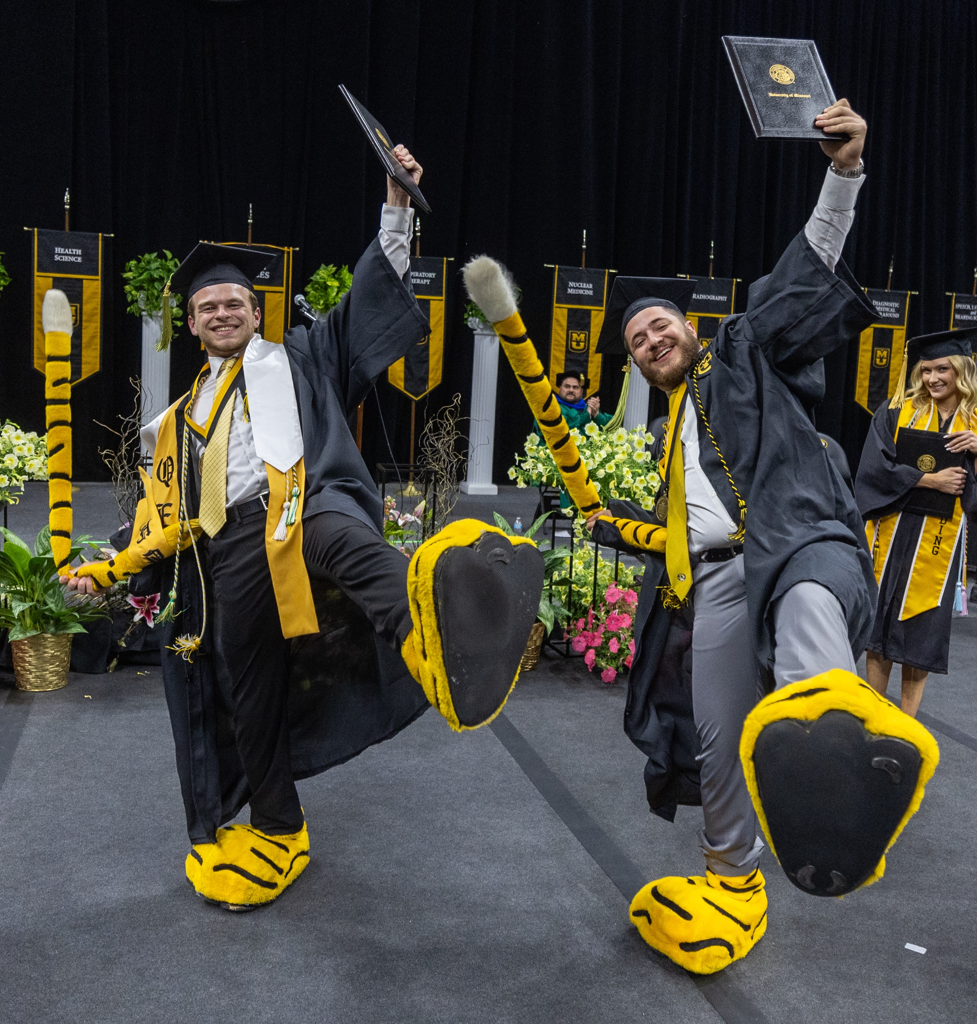
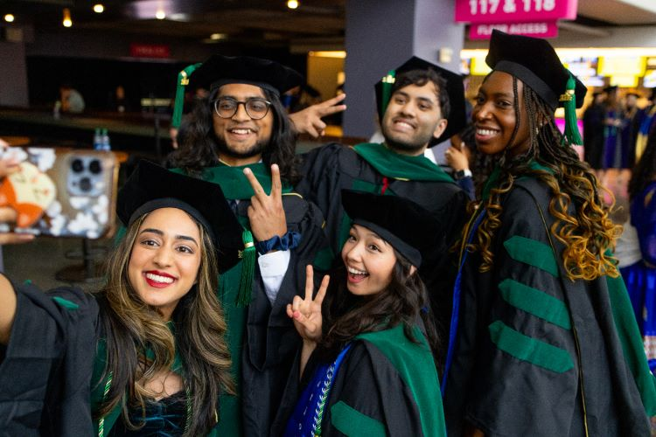
Congratulations Graduates
9,554 total degrees were awarded in Spring 2024.

Slide 18
FYTD Total R&D Expenditures
75%
65%
82%
-10%

Slide 19
FYTD Total Sponsored Expenditures
153%
85%
167%
105%

Slide 20
FYTD Total Sponsored Proposals
114%
79%
46%
43%

Slide 21
FYTD Total Sponsored Awards
136%
203%
183%
171%

Slide 22
FYTD Federal R&D Proposals
120%
66%
26%
0%

Slide 23
FYTD Federal R&D Awards
120%
116%
73%
-6%

Slide 24
FYTD Total R&D Proposals
119%
46%
23%
27%

Slide 25
FYTD Total R&D Awards
101%
163%
74%
10%

Slide 26
IT Update
The MU Division of IT is hosting the semi-annual SEC IT Leadership Meeting in Columbia, MO on June 19-21.
Meeting attendees include VP/CIOs, CISOs, and Research IT leaders from Universities across the Southeastern Conference.
The meeting will take place primarily in Memorial Union. The agenda includes general and breakout sessions, a tour of the MU Research Reactor, and a presentation and discussion led by Matt Sanford. Attendees will also dine together at local Columbia restaurants.

Slide 27
IT Update Software Procurement
A 90-day pilot project is underway to decrease the number and scope of required reviews for click-through software agreements. The end result will be a much more streamlined review process for many software purchases made by faculty and staff. This project is a result of collaboration between DoIT, General Counsel, Risk Management, Procurement, and Information Security. At the end of the pilot period, results will be analyzed to identify next steps, improvements, etc.
The same working group will also begin a review and modernization of business policies associated with IT/software purchases.
We continue to Communicate with MU Faculty Council, the Intercampus Faculty Cabinet, and other constituents on our progress and changes.

Slide 28
IT Update Budget & Funding
On both MU and UM budgets, we are reallocating existing resources to help fund multiple new or critical needs
Leadership positions for MU IT and MU Research IT
Cloud services staff
Research IT support – staff will be added to research-intensive buildings. We are also partnering with the Division of Research, Innovation, and Impact on funding an additional position.
Information Security staff
Application development staff

Slide 29
IT Update Research IT
Google - We are discussing potential partnerships with Google on specific initiatives around Artificial Intelligence, Research computing, and other philanthropic opportunities.
IBM - Research IT leadership is leading the formation of a business case around a partnership with IBM to provide quantum computing capacity to MU and other Missouri universities. Once complete, this business case will be presented to President Choi for review. Other potential interested Universities include Saint Louis University and Washington University.

Slide 30
IT Update Information Security
The Business Continuity Management program is up and running – the Information Security team is conducting business impact analyses on essential enterprise systems.
Risk Assessments are underway - partnering with Baker-Tilly to complete assessments for essential enterprise systems.
Penetration testing will be complete by the end of June 2023. We are partnering with Rubin Brown to perform these tests.
InfoSec Program Review – Partnering with the Eminere Group to identify/illustrate progress, resolution, outstanding issues as a follow up to their 2021 report.
Security Operations Center continues to process record numbers of tickets. We continue to monitor workload to insure appropriate responsiveness and corresponding staffing levels.

Slide 31
IT Update Governance & Leadership
IT Governance
The MU Information Technology Committee call to service has been answered and membership has been established. Communications to committee members will begin within the next month.
UM System IT Leadership
All University CIO roles are now filled, and reporting lines to the VP for IT have been further solidified. The CIO team is working together on identifying strategy and direction regarding shared services, collaborations, etc.
David Gerstenecker is the new UMSL CIO and Executive Director effective 3/18/2024
Barry Robbins is the new CIO for Missouri S&T, effective 5/1/2024.

Slide 32
IT Update Network & Infrastructure
Network Modernization Project update
10/150 buildings complete. Ben Canlas was recently interviewed by EdTech magazine for this effort, specifically around the rollout of WiFi 6E as part of the project.
Arculus CUI Environment
Working with SecureStrux on gap analysis of environment to prepare for certification to occur in late 2024/early 2025. This will allow IT to provide a CMMC Level 2 certified environment as required by certain regulated grant-funded research.

Slide 33
IT Update Enterprise Applications
Advancement – assisting with issues relating to the Ellucian advancement software in use at all four Universities. Issues relate to software functionality, reporting, and data.
IT Service Management – The TeamDynamix implementation continues. We are currently working with stakeholders across UM System, including UM HR, campus IT, and core student-serving offices to establish their service catalogs.

Slide 34
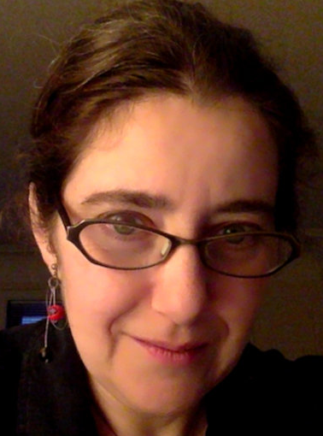
UMSL Major Grant
Geoscience and Artificial Intelligence Application (GAIA) Laboratory
PI: Dr. Sonya Bahar, Professor of Physics and Astronomy
$2M
Sponsor: The Ohio State University; National Geospatial-Intelligence Agency (NGA)
This project will be used to perform innovative research and training in support of NGA Office of Geomatics.
Geomatics is the collection, analysis, and interpretation of data relating to the earth’s surface.
Notes:
THIS IS FROM APRIL –
Options: $3M grant from 11/13/2023 - UMSL receives $3 million grant for new school counseling partnership with Riverview Gardens School District
$2.4M grant from 8/3/23 - James S. McDonnell Foundation awards $2.4 million grant to help St. Louis Anchor Action Network continue its work and expand its impact
Title: Geoscience and Artificial Intelligence Application (GAIA) Lab
PI: Dr. Sonya Bahar, Professor, Physics and Astronomy; Director, Center for Neurodynamics
Co-PIs: None
Amount: $2,083,533
Funding Agency: The Ohio State University; National Geospatial-Intelligence Agency
Description: With the support of Ohio University, via GEO-ESCON, which will serve as the Primary Intermediary (PI), the Department of Mathematics, Physics, Astronomy and Statistics (MPAS) at the University of Missouri at St. Louis (UMSL) proposes to support the NGA’s Office of Geomatics (SFN) by providing excellent student interns to work at GAIA (Geoscience and Artificial Intelligence Application) Lab, an NGA laboratory based out of Moonshot Labs, housed at T-REX. The project will support the NGA’s goal of expanding the local geomatics talent pool. We will target U.S. students in STEM disciplines such as Physics, Geoscience, Computer Science and Mathematics in order to advance geomatics tradecraft by recruiting top local talent to this field.
UMSL will build upon the previous year’s success in collaborating with GAIA Lab, during which six students (four Physics majors and two Computer Science majors) worked with Dr. Dawn King and colleagues at GAIA Lab, producing significant advances in the application of AI to modeling the earth’s gravitational field.

Slide 35
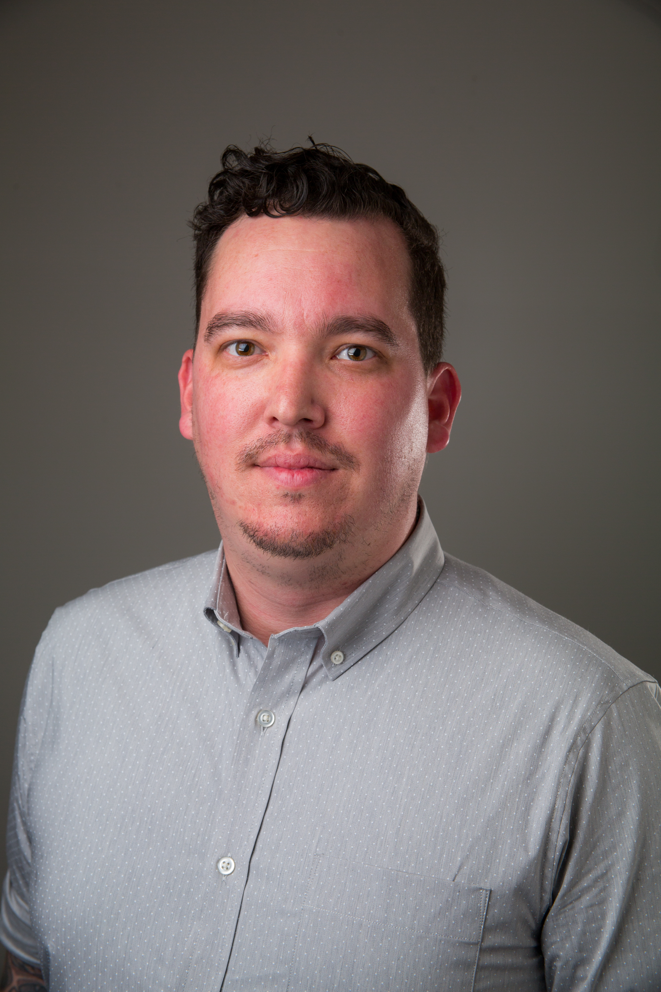
UMKC Major Grant
Comprehensive Human Anatomy Insult Mitigation for Agile Loadouts (CHAInMAIL)
PI: Dr. Stephan Young, Missouri Institute for Defense and Energy
CI:
Dr. Travis Fields, Science and Engineering;
Dr. Ahmed Hassan, Multidisciplinary Multiscale Electromagnetics Lab;
Dr. Ganesh Thiagarajan, Science and Engineering;
Dr. Catherine Johnson, Robert H. Quenon Associate Professor of Mining & Explosives Engineering, Missouri S&T
$1.9M
Sponsor: Army Research Office
The objective of this program is to measure the baseline response of current soldier protection measures and to design and demonstrate new materials that will improve protection from kinetic and non-kinetic forces of potential harm.
Current protective systems are modular to tailor to specific mission needs

Slide 36
GR Update
Over 2,500 bills were filed this session, the legislature passed a total of 28 bills (excluding the 18 budget bills). This is an unusually low number of bills that made it to the Governor’s desk. Below is a list of bills that directly affect UM System that were passed by the legislature this year.
The Governor has until July 14 to sign or veto the following:
SB912 - Military Affairs
SB751 - 340B Contract Pharmacy Protections
SB748 - Renewal of the Federal Reimbursement Allowance (FRA)

Slide 37
MoExcels Projects - $18M
$3.6M – Unmanned Aircraft Systems Hands-On Training
$3.4M – Center for Excellence in Engineering & Information Technology
$1.8M – MO Child Care Workforce Development
$4M – Student Career Pathways & Student Success Space
$3.3M – Bridging the MO Manufacturing Critical Skills Workforce
$1M – Center for Entrepreneurship & Innovation
$675K – Workforce & Career Development Center

Slide 38
Capital Projects - $48M
$20M – MU isotope distribution center
$10M – MU meat processing plant and research facility on East Campus
$3M – Planning and design of MU’s Eckles Hall Wine & Grape Institute
$25M – Construction of a new engineering building

Slide 39
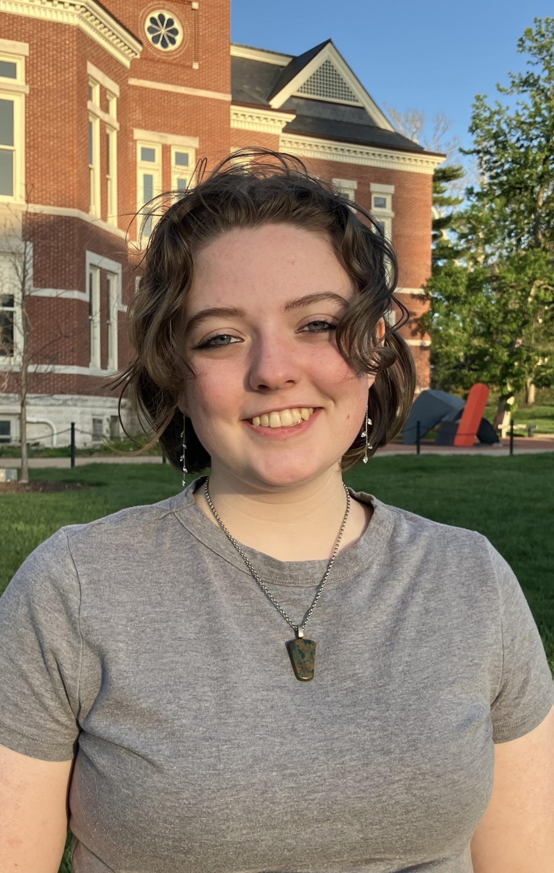
Student Success Highlights
Mason Clynes
Sports Management
Corbin Healy
Law
Finished fifth in the National Collegiate Sports Sales Championship speed sell competition
Chosen as Best Oral Advocate at the 2024 National Trial Competition
Sophia McCann
Geography
Katelyn Kiser
Materials Science and Engineering
Received the Fulbright UK Summer Institutes award
Awarded the 2024 Jean Bye – American Foundry Society Women in Metalcasting national scholarship
Notes:
UMSL: UMKC: Lesly Romo – Henry W. Bloch School of Management Regnier Institute student entrepreneur of the year
MU:
Missouri S&T: A student team from S&T won NASA’s Edison Award in the agency’s BIG Idea Challenge. The team was one of seven finalists in NASA’s 2023 Breakthrough, Innovative, and Game-Changing Idea (BIG Idea) Challenge: Lunar Forge. The students conducted research on producing aluminum on the moon. The competition was held in Cleveland in November. The team was led by Jacob Ortega.

Slide 40
America’s Best Colleges 2024
v
Money Magazine list of nation’s top universities based on graduation rates, cost of attendance, financial aid, alumni salaries and more
S&T also selected as one of the “Best Public Colleges” with a score in top third of ratings
Notes:
Source:
https://money.com/best-colleges/
https://money.com/best-colleges/best-public-colleges/

Slide 41
Top 100 Universities Granted U.S. Utility Patents
65/100 U.S. Universities
35/67 Public Universities
Ranking | Institution | # of Patents
63 | University of Houston | 27
63 | University of Rochester | 27
65 | Colorado State University | 26
65 | Drexel University | 26
65 | University of Arkansas | 26
65 | UM System | 26
65 | University of Cincinnati | 26
65 | University of Iowa | 26
71 | University of Connecticut | 25
72 | Brown University | 22
Ranking | Institution | # of Patents
33 | University of New Mexico | 28
33 | University of Tennessee | 28
34 | University of Houston | 27
35 | Colorado State University | 26
35 | University of Arkansas | 26
35 | UM System | 26
35 | University of Cincinnati | 26
35 | University of Iowa | 26
36 | University of Connecticut | 25
Source: The National Academy of Inventors, 2023

Slide 42
Admissions Update
Graduate Applicants
Graduate Admits
6/10/24 | 2022​ | 2023​ | 2024
MU​ | 4,011 | 4,089 | 4,156 (2%)
UMKC​ | 4,455 | 4,010 | 2,968 (-26%)
S&T​ | 4,042 | 6,256 | 5,712 (-9%)
UMSL​ | 2,667 | 2,335 | 1,655 (-29%)
6/10/24 ​ | 2022​ | 2023​ | 2024
MU​ | 1,765 | 1,735 | 1,645 (-5%)
UMKC​ | 1,979 | 1,804 | 1,516 (-16%)
S&T​ | 1,616 | 2,689 | 1,929 (-28%)
UMSL​ | 1,059 | 1,203 | 904 (-25%)

Slide 43
Fall Degree Completions
Undergraduate
Graduate/Professional
 | 2020 | 2021 | 2022 | 2023
MU | 5,641 | 5,114 | 5,092 | 5,944
UMKC | 1,903 | 1,808 | 1,623 | 1,634
S&T | 1,423 | 1,427 | 1,325 | 1,205
UMSL | 1,888 | 1,889 | 1,786 | 1,493
 | 2020 | 2021 | 2022 | 2023
MU | 2,379 | 2,306 | 2,435 | 2,419
UMKC | 1,531 | 1,733 | 1,673 | 2,126
S&T | 877 | 861 | 750 | 814
UMSL | 842 | 914 | 839 | 908

